Slide 1

This reserve study report template uses a format that is credited to McKinsey & Company for creating clear, concise reports … many major corporations use this format for their consulting work.
Instructions
Instructions
The McKinsey Presentation Style
Landscape style report. Often associated with PowerPoint.
Report suitable for stand-up presentation to live audience.
Each page has a heading statement that is generally a complete sentence.
The details on each page support the heading.
The headings from page-to-page tell a story … a person reviewing the report can read only the headings and gain a good understanding of the entire report.
This format minimize unnecessary text and focuses on meaningful data and numbers.

Slide 2
This format is preferred by many consulting firms as a deliverable over traditional “white-paper” style documents.
Instructions
Instructions
Exhibit large amount of data in concise format.
Heavy use of graphics without textual boilerplate.
Keeps the report to highlights without unnecessary text or data.
The report suitable for stand-up presentation to live audience or as a deliverable to a reading audience.
Provides the medium to keep the report graphic and appealing … using the “less is more” concept. White paper style documents typically will take longer for the reader to digest.
Focuses on distilling only the most important points that matter to the audience … in this case:
  How are we doing?
  What are the key performance factors?
  What, if any, are areas of exposure?
  What do we need to improve?
  How much will it cost?
This style of report is the preferred medium for delivering reports by many major corporations. For example:
McKinsey & Company
KPMG
IBM
Deloitte
Leanplum
Ernst & Young

Slide 3
This report template is the preferred format by the author.
Instructions
Instructions
Users are free to use this template to develop their own analysis
This report template is designed to be used for a reserve study update with financial analysis.
For a first-time reserve study, generally the content will be more inclusive.
Update this table
Copy and paste from RFA
Edit text to describe the current environment.
Depending on size of graphics, you may have to use more than one page.
In this template, there are callouts and notes to highlight action or edits. Perform the action / edit and delete the callout.

Slide 4
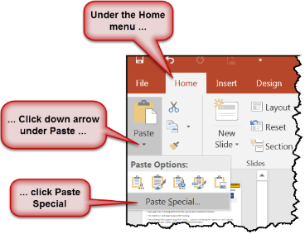
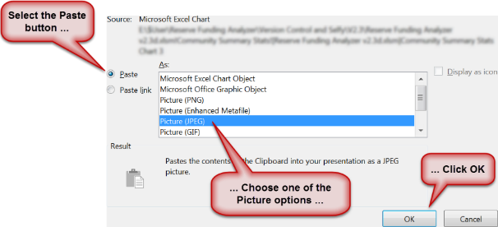
Usage Note: — After copying an object in Excel, go to PowerPoint and paste using the Paste Special option.
Instructions
Instructions

Slide 5
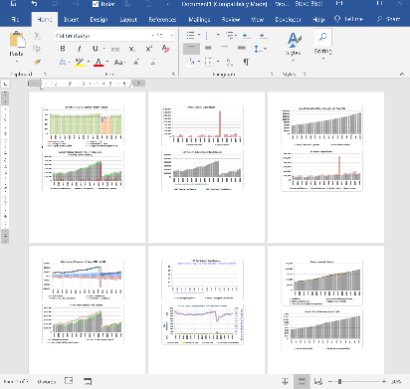
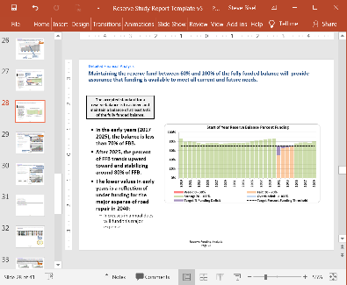
Besides performing a manual copy and paste … you can use the built-in utilities in the RFA to copy relevant charts and tables into a Word document, then select the elements you want to copy to this PowerPoint document.
Instructions
Instructions
Word document created by utility in RFA
Select and copy any image …
… and paste directly into PowerPoint

Slide 6
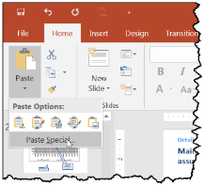
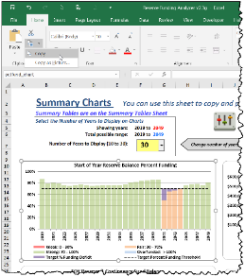
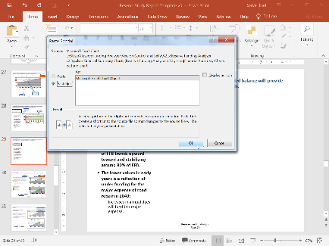
If you are familiar with advanced features of Microsoft Office, you can also create active links from the RFA directly to PowerPoint and when an update occurs in Excel (the RFA), it will synchronize with the target link in PowerPoint.
Instructions
Instructions
Select object (chart or table) in Excel and click copy …
… Select “Paste” then click “Paste Special” in PowerPoint …
… then select “Paste Link” and click OK.

Slide 7
At a minimum, a reserve study must consist of the following elements:
Instructions
Instructions
A reserve component list
  Estimated useful life
  Remaining useful life
  Estimated current cost for replacement or maintenance
The current status of the reserve fund
Identification of cash reserves set aside for reserve component maintenance / replacement
A projected reserve account balance for 30 years and a funding plan to pay for projected costs from the reserve fund
  Determine a stable and equitable funding plan to offset ongoing reserve component deterioration with the projected sources of income required to meet future expenses
  Funding plan should be prepared on the cash flow basis
A description of the methods and objectives utilized in computing the fund status and in the development of the funding plan.
The total cash reserves expressed as a percentage of current replacement costs and the current deficiency in reserve funding on a per-unit basis
Statement of the methods used to develop estimates and funding plan
A statement of any outstanding loans
A description of the assumptions utilized for interest and inflation, tax and other outside factors for the financial analysis.
Current reserve account contribution rate and the sources of the contributions
  Annual dues
  Special assessments
  Other income sources
The RFA addresses all of these items

Slide 8
Reserve Study Report and Funding Analysis
This is a sample Title Page. You will need to update this date.
05 January 2020
Name this title to your liking.

Slide 9
This is a sample of Section Break Page
Executive Summary
Methodology and Strategy
Detailed Financial Analysis
Reserve Component Inventory
Expense and Income Summaries
Summation
Move this bar to the correct section title
Change this text to match title of each section in the report

Slide 10
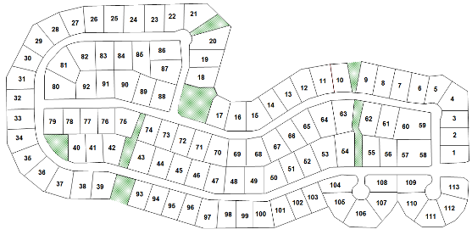
This Reserve Analysis is prepared for Our Association.
This section should match the section break page
Executive Summary
Update this table to describe your current community or HOA
Name of Association | Our Association Name
City and State | My City, My State
Type | Single family detached homes
Number of Units | 113
Age | 22 years, community founded 1995
Fiscal Year End | 31 Dec 2020
Level of Reserve Study | Update Reserve Study with Site Visit
Management Company | Our Mgt Company
Date Prepared | 01 February 2020
Funding Strategy for Analysis | Threshold Funding
You can place a map or other graphic here.

Slide 11

The financial outlook for the association is excellent. The association’s reserve balance is 86% of the fully funded balance and is considered very strong with a very low risk of a special assessment.
Executive Summary
Change text to suit
Change text in slide title to suit
The projected funding plan for the next 30 years will provide the funding necessary to meet all anticipated expenses.
Copy and paste from RFA
Copy and paste from RFA
Copy and paste from RFA

Slide 12
HOAs have a responsibility to establish and maintain a Replacement Reserve Fund to provide the maintenance or replacement of association depreciable components.
Executive Summary
The objectives of a Reserve Study or Analysis should include the following:
Provide a current estimate of the costs of repairing and replacing major common area components over the long term.
All major repair and replacement costs will be covered by funds set aside by the association as reserves, so that funds are available when needed.
An examination of the association's repair and replacement obligations is conducted.
The costs and timing of replacement are determined
Distributes the contributions of old and new owners.
  Major items deteriorate with use and age.
  Every owner who uses the association's assets pays for a share of replacement / maintenance.
Allows for the aesthetic qualities of the community to be maintained.
Strive to minimize the need for special assessments.
Shows owners and potential buyers a more accurate and complete picture of the association's financial strength and market value.
Disclose to buyers, lenders, and others the manner in which management of the association is making provisions for both annual and non-annual maintenance requirements.
Define explicit association decisions on how to provide for long-term funding.
Provide or contribute to a maintenance planning tool for the association.
This page can be used as is

Slide 13
This Reserve Study provides long-term capital budget planning, identifies the current status of the reserve fund and provides a long-term stable and equitable funding plan to offset ongoing deterioration of reserve components.
Executive Summary
Preparation
Assumptions
Prior reserve studies, if available, were used as references for this analysis.
  Baseline for identification of reserve asset components
The HOA Community Manager and members of the Board conducted an inventory of the reserve assets:
  If available, prior reserve studies reserve assets inventory
  Conduct current inventory of reserve assets
  Verified that no assets were overlooked
  Condition of assets and useful life was evaluated by community manager, knowledgeable members of the community and outside service providers.
The physical inventory and condition assessment of all physical assets is complete.
The valuation cost estimates are reasonably accurate.
Estimates for current and future operational expenses are reasonably accurate:
  Annual expenses such as insurance, administration, maintenance
  Expenses less than $1000 are considered operational
  Future operational expenses are projected to rise at the projected inflation rate
Update this value.
The Funding Plan Goals
  Provide sufficient funds when required
  Enable a stable contribution rate over the years
  Evenly distribute contributions over the years
  Be fiscally responsible
This page can be used as is

Slide 14
Executive Summary
Methodology and Strategy
Detailed Financial Analysis
Reserve Component Inventory
Expense and Income Summaries
Summation

Slide 15
Reserve studies are conducted using one of three types. This analysis was conducted using the method indicated.
Methodology and Strategy
This Report | Reserve Study Type
 | Full Study – On-site Inspection Creation of the all components list Measuring/quantifying all reserve components Development of the Useful Life, Remaining Useful Life, and Current Replacement Cost
 | Update With Site Visit Updates an existing reserve study Review of all components to assure proper identification and quantity New components identified Knowledgeable vendors and service providers consulted to assure correct costs and useful lives are assessed
 | Update Without a Site Visit Updates an existing reserve study without a site inspection Performed by interviews
Move this arrow to indicate which report type.
Once you have indicated the report type, this page is good to go

Slide 16
Economic assumptions and target objectives were established in the development of this Reserve Study Report.
Methodology and Strategy
Copy and paste from RFA

Slide 17
The Cash Flow Reserve Funding methodology was used in the analysis as it allows reserve funds to be used efficiently and evenly spreads costs among the community owners over the years.
Methodology and Strategy
Change text in slide title to suit
Reserve Funding Methodologies
Characteristics
Cash Flow
  The reserve fund is considered one large pool of money.
  Contributions are established by testing and retesting different contribution rates until the desired funding objective is achieved.
Straight Line (or Component Level)
  Component costs are calculated separately, and summed together.
  The reserve funds are essentially divided into separate pools for each component, with no co-mingling.
  Common method before widespread use of computers to perform multiple calculations simultaneously.
Cash Flow:
  Encourages the use of threshold levels to test various funding strategies with respect to funding requirements.
  May increases risks of underfunding and special assessments, but this can be mitigated by:
    Understanding of component costs and useful life
    Setting reasonable threshold funding levels
    Careful analysis of annual cash flows
  Typically, results in a lower rate of reserve contributions as the funds can be used more efficiently; and the contributions are more evenly spread over the years.
Straight Line
  As each component funding stands on its own, each component is considered to be fully funded.
  Does not allow flexibility should a component cost differ from the budgeted amount.
Move the grey boxes to highlight the methodology and characteristics
This page can be used as is

Slide 18
The Threshold Funding strategy is used to keep the annual dues low whilst maintaining a low risk of exhausting funds in any given year.
Methodology and Strategy
Funding Strategies
Characteristics
Fully Funding Strategy
  Setting a reserve funding goal of keeping the reserves at or near 100% funded.
Threshold Funding Strategy
  Setting a Reserve funding goal of keeping the Reserve balance above some threshold, generally less than the Fully Funding Model.
Baseline Funding Strategy
  Setting a reserve funding goal of keeping the reserve cash balance at the end of each year in the overall reserve funding projection at or above $ 0.
Statutory Funding Strategy
  Based on local statutes where associations set aside specific cash amounts, or specific thresholds are set, as required by statutes.
The Full Funding strategy is the most conservative as all components will be fully funded over all years.
  Minimizes risk of under funding resulting in the need for special assessments or deferred maintenance.
The Threshold Funding strategy reduces the annual contribution (compared to Full Funding) for maintaining the reserve.
  Must be used rationally to assure that under funding does not occur in any years.
  Requires careful analysis of expenses and funding over all years.
  Reduces annual contribution to reserve fund compared to Full Funding strategy.
The Baseline Funding strategy tends to have the lowest annual contributions, but increases the likelihood of under funding that may require special assessments.
  If used, communities must very closely monitor all components to understand changes in useful life.
Move the grey boxes to highlight the strategy and characteristics
Change text in slide title to suit

Slide 19
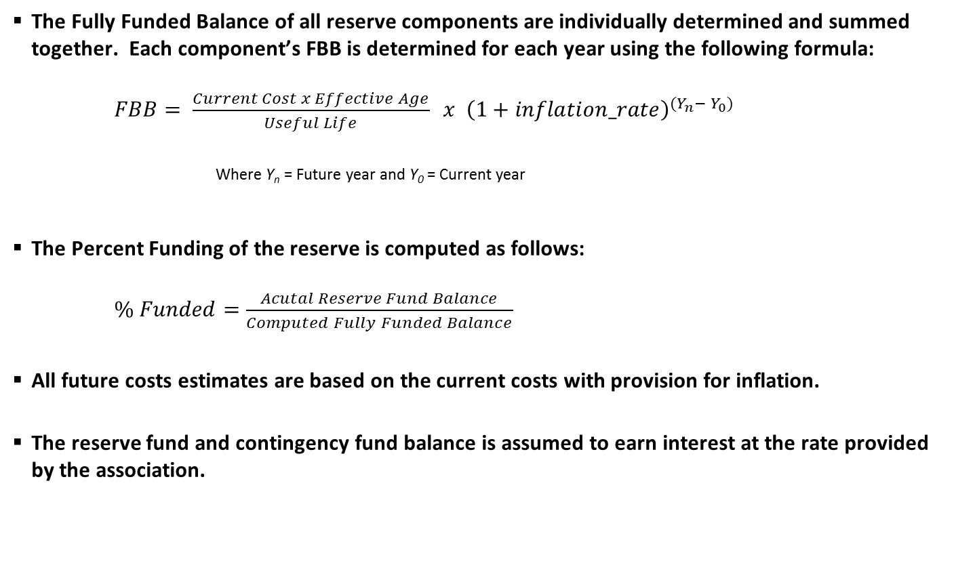
Two key performance indicators used in this analysis are “Fully Funded Balance” and “Percent Funded” … an explanation of each of these terms is shown below.
Methodology and Strategy
The Fully Funded Balance of all reserve components are individually determined and summed together. Each component’s FBB is determined for each year using the following formula:
$FBB= \frac{Current Cost x Effective Age}{Useful Life} x {\left(1+inflation_rate\right)}^{(Y_{n}− Y_{0})}$
Where Yn = Future year and Y0 = Current year
The Percent Funding of the reserve is computed as follows:
$\% Funded=\frac{Acutal Reserve Fund Balance}{Computed Fully Funded Balance}$
All future costs estimates are based on the current costs with provision for inflation.
The reserve fund and contingency fund balance is assumed to earn interest at the rate provided by the association.
This page can be used as is

Slide 20
A sensitivity analysis was conducted to assess the effect that high cost reserve components may have on the reserve funding over the next 30 years
Methodology and Strategy
A sensitivity analysis determines how different values of an independent variable affect a particular dependent variable under a given set of assumptions.
Within the bounds of this reserve funding analysis, the following parameters were varied to determine the effect upon the funding plan:
  Assumed annual inflation
  Varying the Remaining Useful Life of key reserve components (reducing or increasing the Remaining Useful Life)
  Varying the inclusion, costs and/or deployment dates of any special projects
  Other factors as noted in this report
If you do not conduct sensitivity analysis, then delete this page.

Slide 21
Executive Summary
Methodology and Strategy
Detailed Financial Analysis
Reserve Component Inventory
Expense and Income Summaries
Summation

Slide 22
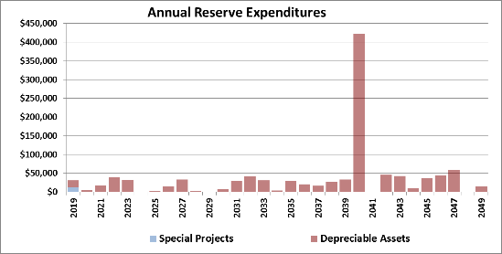
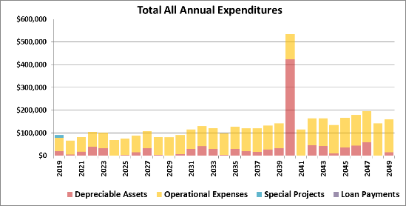
Over the next 30 years, the association must provide $4.1 M for all operational and reserve funding expenses.
Detailed Financial Analysis
Change text in slide title to suit
Copy and paste from RFA

Slide 23
The operational fund expenses are projected to rise year-to-year keeping pace with the assumed rate of inflation.
Detailed Financial Analysis
Routine Items in the Operational Fund
  Admin expenses
  Gate maintenance
  Postage & Copies
  Accounting services
  Legal services
  Insurance
  Income taxes
  Property taxes
  Other taxes, licenses and fees
  Utilities (electricity, water and telephone)
  Landscaping services
  Management services
  Street sweeping services
3% Inflation
You can add embellishments if you wish.
Copy and paste from RFA

Slide 24
Over the next 30 years, the HOA will need to allocate $1,449,000 from the reserve fund toward maintenance or replacement of reserve components.
Detailed Financial Analysis
Change text in slide title to suit
Copy and paste from RFA

Slide 25
To meet future operational and reserve funding requirements, the HOA will need to increase the overall income through increases in annual dues.
Detailed Financial Analysis
No Special Assessments
You can add additional embellishments or notations.
Copy and paste from RFA

Slide 26
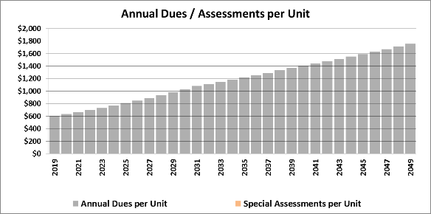
The proposed annual dues increases will provide the necessary funding required for operational expenses and to maintain or replace the association’s depreciable assets for the next 30 years.
Detailed Financial Analysis
Copy and paste from RFA
Copy and paste from RFA

Slide 27
The actual increase in annual dues per unit the current rate of $623 per year to $1402 per year over the next 30 years is closely aligned with the estimated annual inflation rate.
Detailed Financial Analysis
Change text in slide title to suit
Gradual Increases
You can add additional embellishments or notations.
Copy and paste from RFA

Slide 28
Maintaining the reserve fund between 60% and 100% of the fully funded balance will provide assurance that funding is available to meet all current and future needs.
Detailed Financial Analysis
Edit this text to describe your environment
The accepted standard for a reserve balance is to achieve and maintain a balance of at least 60% of the fully funded balance.
Copy and paste from RFA
In the early years (2017 – 2025), the balance is less than 70% of FBB.
After 2025, the percent of FFB trends upward toward and stabilizing around 80% of FFB.
The lower values in early years is a reflection of under funding for the major expense of road repair in 2040:
  Increases in annual dues will fund this major expense.

Slide 29
The Association has established a target of 70% of the Fully Funded Reserve Funding as this will provide high confidence that annual expenditures can be met each year over the next 30 years.
Detailed Financial Analysis
Copy and paste from RFA
Change text in slide title to suit
Funding Goal Range
  The financial objective is to achieve and maintain the reserve balance to be within the range of 60% to 100% of the fully funded balance
  Attain goal without requiring any special assessments
Income must be enough to achieve and maintain the funding goal
  Annual dues must rise to keep pace with inflation.
  Total income must be sufficient so that funds are available to meet all operational and reserve expenditures.
Sources of annual income include:
  Annual association dues
  Special assessments
  Sale of assets
  Loans
  Other income sources
Copy and paste from RFA

Slide 30
It is a good practice, and Our Association should maintain, a contingency fund to meet unexpected expenses.
Detailed Financial Analysis
If you are not including a contingency fund, then delete this page. Otherwise, update by copy and pasting graphics and update the text fields
Currently, the HOA does not have a contingency fund.
The contingency fund is kept separate from the reserve fund.
As the name implies, the contingency fund is used to meet unexpected expenses.
The contingency fund will be established and maintained to be no less than 5% of the reserve fund balance.
Current Contingency Fund Balance | Contingency Fund Percent

Slide 31
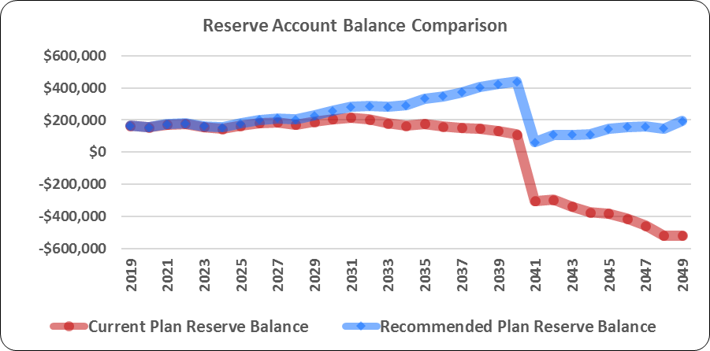
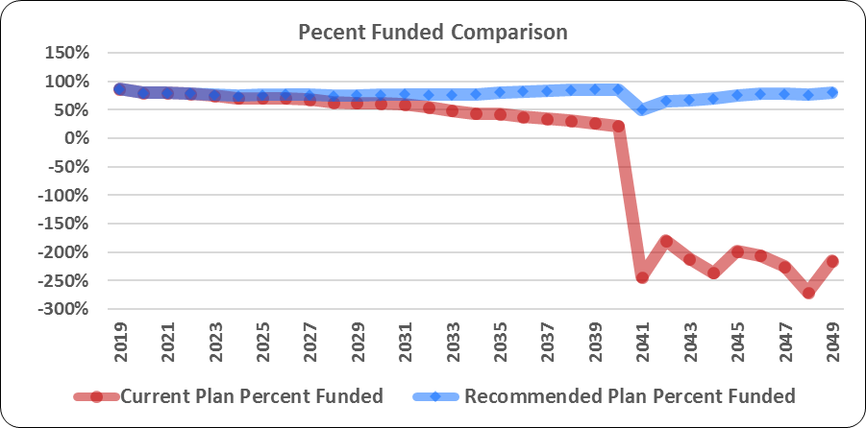
The charts below illustrate the current funding plan compared to the recommended funding plan.
Detailed Financial Analysis
Copy and paste from RFA
Copy and paste from RFA

Slide 32
Executive Summary
Methodology and Strategy
Detailed Financial Analysis
Reserve Component Inventory
Expense and Income Summaries
Summation

Slide 33
Our Association has the responsibility to maintain or replace the following depreciable components over the next 30 years.
Reserve Component Inventory
Copy and paste from RFA
Depending on size of the table, you may have to use more than one page.

Slide 34
Reserve Component Inventory …
Reserve Component Inventory
Although not necessary, if you want to include component details you can do so. Copy and paste from the RFA

Slide 35
… Reserve Component Inventory …
Reserve Component Inventory

Slide 36
… Reserve Component Inventory …
Reserve Component Inventory

Slide 37
… Reserve Component Inventory
Reserve Component Inventory

Slide 38
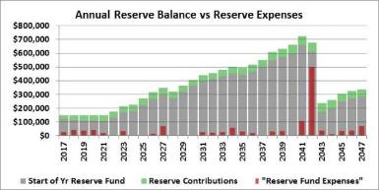
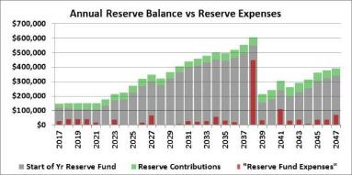
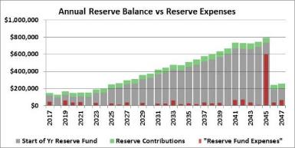
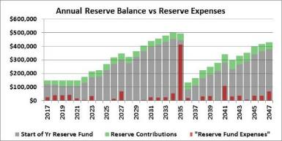
To assess the effect that the major cost component, Road Resurfacing, has on the reserve funding, a sensitivity analysis was conducted.
Reserve Component Inventory
Reserve Component | Today’s Cost | Estimated Remaining Useful Life | What-If Remaining Life +2 years | What-If Remaining Life -2 years | What-If Remaining Life +5 years | What-If Remaining Life - 5 years
Overlay & replace road surface (highest single reserve component) | $225,000 | 23 years | 25 years See Chart 1 | 21 years See Chart 2 | 28 years See Chart 3 | 18 years See Chart 4
Change text in slide title to suit
Chart 1: Changing Road Resurfacing to 2042
Chart 2: Changing Road Resurfacing to 2038
This is optional page if you wish to demonstrate the sensitivity analysis that was conducted.
Chart 3: Changing Road Resurfacing to 2045
Chart 4: Changing Road Resurfacing to 2035

Slide 39
Executive Summary
Methodology and Strategy
Detailed Financial Analysis
Reserve Component Inventory
Expense and Income Summaries

Slide 40
With the proposed annual dues increases, the total income will be sufficient to meet all the expected expenses for the HOA …
Expense and Income Summaries 2017 - 2026
Copy and paste from RFA

Slide 41
… With the proposed annual dues increases, the total income will be sufficient to meet all the expected expenses for the HOA …
Expense and Income Summaries 2027 - 2036
Copy and paste from RFA

Slide 42
… With the proposed annual dues increases, the total income will be sufficient to meet all the expected expenses for the HOA
Expense and Income Summaries 2037 - 2047
Copy and paste from RFA

Slide 43
Through modest and reasonable dues increases, the HOA can achieve the funding requirements to meet future reserve expenditures.
Expense and Income Summaries
Copy and paste these 3 charts from RFA

Slide 44
Over the next 30 years, reserve components will require periodic replacement or maintenance to maintain their usefulness.
Expense and Income Summaries – Component Maintenance Schedule
If too many components to list on one page, consider only showing the next five years or adding more pages.
In point of fact, showing all 30 years in a report is superfluous.
Copy and paste from RFA

Slide 45
Executive Summary
Methodology and Strategy
Detailed Financial Analysis
Reserve Component Inventory
Expense and Income Summaries
Summation

Slide 46
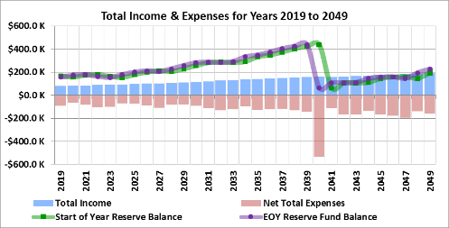
The proposed funding strategy will fund any given year’s expenses – without any special assessments – and will maintain a sound financial status for the next 30 years.
Summation
Change the summary text tailored for your HOA
Copy and paste from RFA
Copy and paste from RFA

